Slide 1

Learning Intention: Today we are learning about the utilitarian view of CP
Success Criteria:
By the end of the lesson you will have:
. Reacquainted yourself with this non religious theory.
. Have learnt two quotes.
. Be clear about the Utilitarian stand point.

Slide 2

Course content
Morality and justice
Purposes of punishment
reformation
retribution
protection
deterrence
Responses to crime
custodial sentences
non-custodial sentences
capital punishment
Religious and non religious views on these issues

Slide 3

Utilitarianism
Utilitarianism is an ethical and philosophical theory that determines right from wrong by focusing on outcomes.
It is a form of consequentialism.
Of all the things a person might do at any given moment, the morally right action is the one with the best overall consequences.
Internet Encyclopedia of Philosophy: Consequentialism

Slide 4
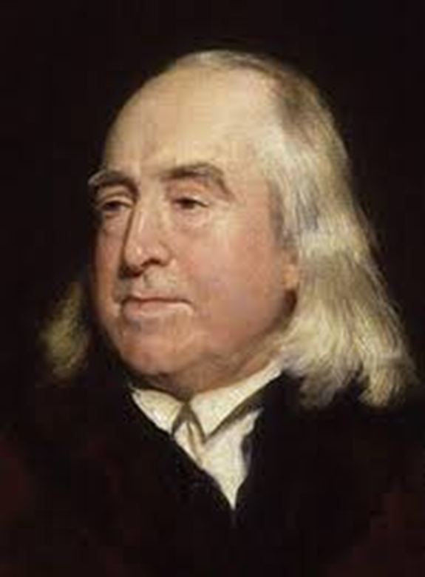
The founder of utilitarianism was?
Jeremey Bentham

Slide 5
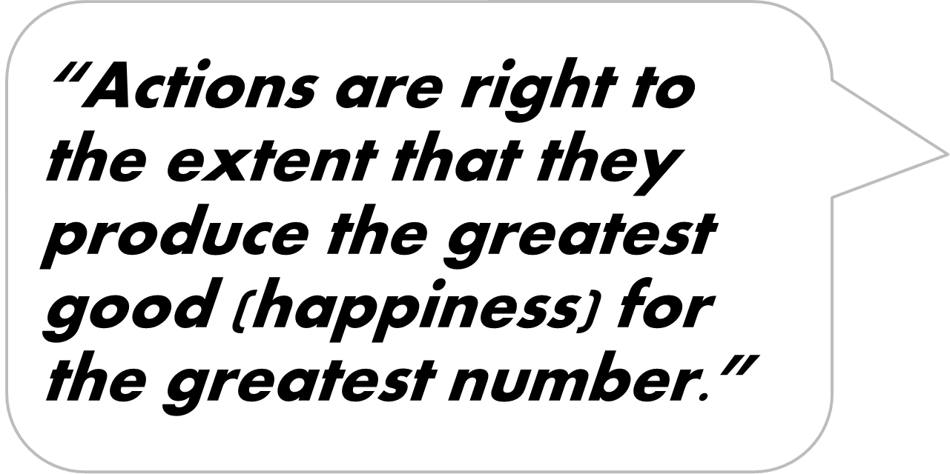
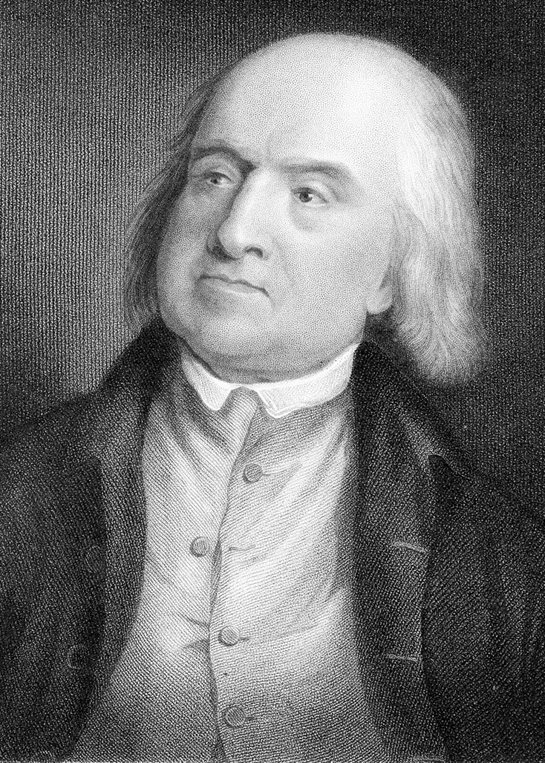
Learn this quote

Slide 6
Bentham was an act Utilitarian, meaning……
Bentham cared about the consequences or actions
of any choice .
He even devised a way of calculating every action and rating it for pain and pleasure. It is called the Hedonic Calculus

Slide 7
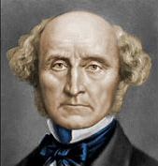
But then we have this chap….. Who is he?
John Stuart Mill

Slide 8
He had slightly different views to Bentham and because of this he was called a rule utilitarian’. This means…..
He believed that humans knew from experience the kind of actions that produce pleasure or cause pain.
Because of this we can come up with general moral principles/rules that should be followed in the majority of cases.

Slide 9
When it comes to punishment overriding everything Bentham says:
“ All punishment is mischief: all punishment is evil ”
Learn this quote

Slide 10
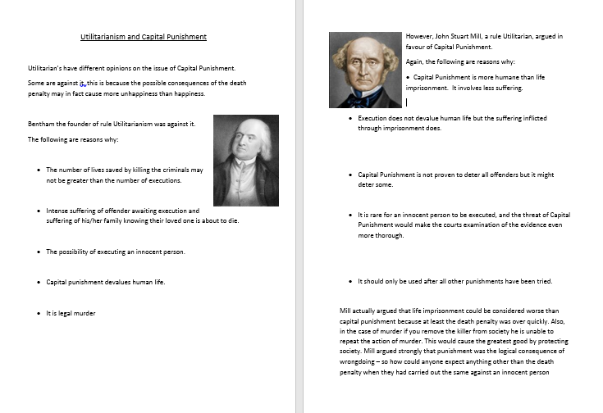
The utilitarian view on Capital punishment is interesting because they both agree and disagree with it!
Take a look at this information sheet and lets read it carefully.
Fill in the spaces underneath each point with your own reflections on this, or a fact that corresponds to it.

Slide 11
Learn this quote
“ All punishment is mischief: all punishment is evil ”

Slide 12

Lets watch this clip to help us focus our thinking
https://www.bbc.co.uk/teach/class-clips-video/religious-studies-pshe-gcse-what-are-the-rights-and-wrongs-of-the-death-penalty/zbkg92p

Slide 13
What do you know? Create a mind map which includes the different aspects of the lesson we have done today. Make sure you know those quotes.
Utilitarian view of CP

